Slide 1
How to build a search engine(2)
Web Crawler

Slide 2
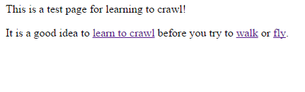
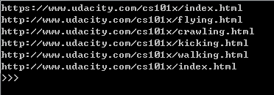
Web crawler
Following the links to find the page
D
E
A
A
B
C
B
Seed URL
None
F
D
https://www.udacity.com/cs101x/index.html

Slide 3
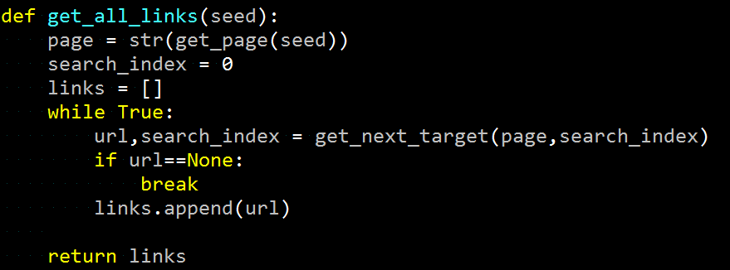
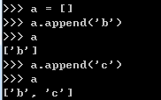
1. How to store the data?
<list>.append

Slide 4

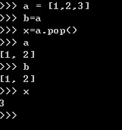
2. <list>.pop()
Remove the item at the given position in the list, and return it. If no index is specified, a.pop() remove and return the last item in the list.

Slide 5
3. Set
- A set is an unordered collection with no duplicate elements. Basic uses include membership testing and eliminating duplicate entries.
{}
S = {7, ’Veil’, 0, -29 , (“x”,11), ”sun”, frozenset({8,4,7}) , 913}
7
’Veil’
frozenset({8,4,7})
”sun”
-29
S
0
(“x”,11)
913

Slide 6
Exercise:
If p is a list (ex. [1,2,3]),and so is q but with different number(ex.[1,3,5].
Define a union function such that,
if q is not in p, append this value to p
Ex: union([1,2,3],[1,3,5]) → [1,2,3,5]

Slide 7
4. Crawling process
How to do it if we want to crawl out all the links regarding seeding page
tocrawl | crawled | Number of crawling
[seed] | [] | 0
[A,B,C] | [seed] | 1
[B,C,D,E] | [seed,A] | 2
[C,D,E] | [seed,A,B] | 3
[D,E,F] | [seed,A,B,C] | 4
[E,F] | [seed,A,B,C,D] | 5
[F] | [seed,A,B,C,D,E] | 6
[] | [seed,A,B,C,D,E,F] | 7
D
E
A
A
B
C
B
Seed URL
None
F
D

Slide 8
Homework
Finished Crawl_web.py
Seed url = 'https://www.udacity.com/cs101x/index.html'

